Slide 1
Key structures Spermc
Year 11 Ancient History
Unit 1, Week 1: Lesson 2

Slide 2
DIscussion
What do we already know about Macedonian society?

Slide 3
Today’s lesson:
Key social, political, economic, religious, political, military and cultural structures/institutions of Macedonia
ACTIVITY:
Create a mind map on an A3 piece of paper
We will summarise/dot-point ideas about Macedonian society
You will need 6 different coloured textas/pencils to colour co-ordinate your page!
This will assist in organisation of ideas and memorisation
To be stapled in your book at the end of the lesson

Slide 4
Social structures
Evidence we have focusses on the elites and upper classes
Macedonian elite were called hetairoi, or companions.
The hetairoi met at symposia, or big meetings, where they would come together and compete for influence and the king's favour.
These symposia were notorious for drunken brawls and other debauchery.
Macedonian women had limited rights. But they were a little better off than women in Greek city-states like Athens, who were almost always secluded at home.
Macedonians also tended to own fewer slaves than the Greeks.

Slide 5
Political structures
Unlike Greek city-states that had a kind of democratic government, Macedonia was a hereditary monarchy: kingship was handed down to another member of the family.
Kings often polygamous, meaning they had many wives,
Succession was sometimes controversial, with various children from various mothers all rivals to be the heir.
King was the head of state, the commander of the armed forces, and also the head of the religion: the power to mint coins and circulate money.
Even though the king had ultimate power, he did convene a council called the synedrion. The synedrion was made up of high-ranking Macedonian men, and they would meet to discuss issues and give the king advice. The king didn't get to choose the members of the synedrion because some of them had been guaranteed a spot by birthright.
The first known Macedonian king is Caranus, and King Amyntas III was the first to really unify all of the regions of Macedonia. The major ruling dynasty of Macedonia was the Argeads, who gave us King Philip II and Alexander the Great, who expanded and strengthened Macedonia.

Slide 6
Economic structures
Early on, the Macedonian economy relied on its timber resources. Then, they began to acquire some gold and silver mines, and charge port duties.
There was a big gap between the rich elites and the poor, but as Philip II expanded Macedonian lands, the economy grew.
Under Philip II and Alexander the economy became monetary, which means that coins were issued and used everywhere as money.
That's a sign of a much more prosperous economy because coins make business transactions go much faster than negotiating and bartering a stack of timber for some sheep.

Slide 7
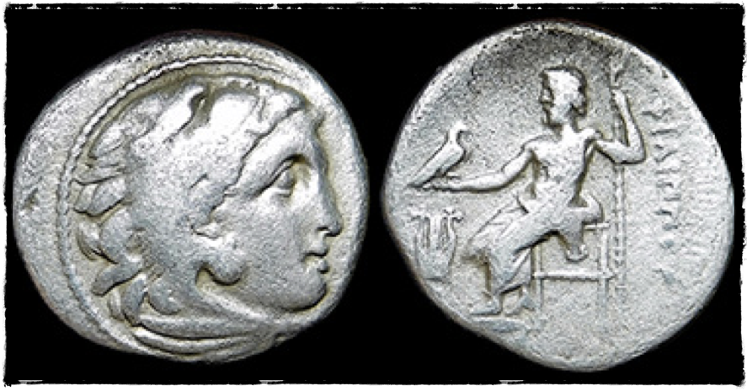
Philip III of Macedon, 323-300 BC. Silver drachm, Kolophon mint, struck c. 323-319 BC.
Head of Alexander as Herakles clad in Nemean lion skin rt. / Zeus enthroned left, holding eagle and scepter, lyre to left, ΦIΛIΠΠOY behind.

Slide 8
Religious structures
Same Gods as Greeks: worshipped the 12 Olympians
Zeus was the single most important deity
Makedon, the mythical ancestor of the Macedonians, was held to be a son of Zeus, and Zeus features prominently in Macedonian coinage.
The most important centre of worship of Zeus was at Dion in Pieria, the spiritual centre of the Macedonians, where beginning in 400 BC King Archelaus established an annual festival, which in honour of Zeus featured lavish sacrifices and athletic contests
Worship of Zeus's son Heracles was also prominent; coins featuring Heracles appear from the 5th century BC onwards.
This was in large part because the Argead kings of Macedon traced their lineage to Heracles, making sacrifices to him in the Macedonian capitals of Vergina and Pella.
Importance of the worship of Artemis. Artemis was often depicted as a huntress and served as a tutelary goddess for young girls entering the coming-of-age process, much as Heracles Kynagidas (Hunter) did for young men who had completed it.

Slide 9
Religious structures
Macedonian elite built lavish tombs at the time of death rather than constructing temples during life
Macedonian burials contain items similar to those at Mycenae, such as burial with weapons, gold death masks
Macedonian monarchs seen as Gods: began with the death of Philip II, yet it was his son Alexander the Great who unambiguously claimed to be a living god
Alexander visits the oracle of Didyma in 334 BC to confirm his divine status: priest there convinced him that Philip II was merely his mortal father and Zeus his actual father, Alexander began styling himself as the 'Son of Zeus’,

Slide 10
Military structures
One of Philip's most important achievements: reforming the Macedonian army - Introduced lighter weaponry and an extra long pike or spear called a sarissa.
Philip took the soldiers on forced marches carrying their gear to get them in battle shape
Improved some tactics he learned in Greece like the phalanx, in which soldiers marched together in a tight formation like a finger. He improved siege warfare with better catapults and used cavalry forces together with ground troops in a revolutionary way.
King Philip II had grand visions of taking over all of Greece and parts of Asia, but he knew that he would have to be clever and patient. He used all sorts of diplomatic strategies, and even bribes, to placate and conquer Greek city-states.
He was brilliant at playing city-states against one another, inflaming their rivalries so that they would not unite against him. When the time was right, he would strike with his elite military.

Slide 11
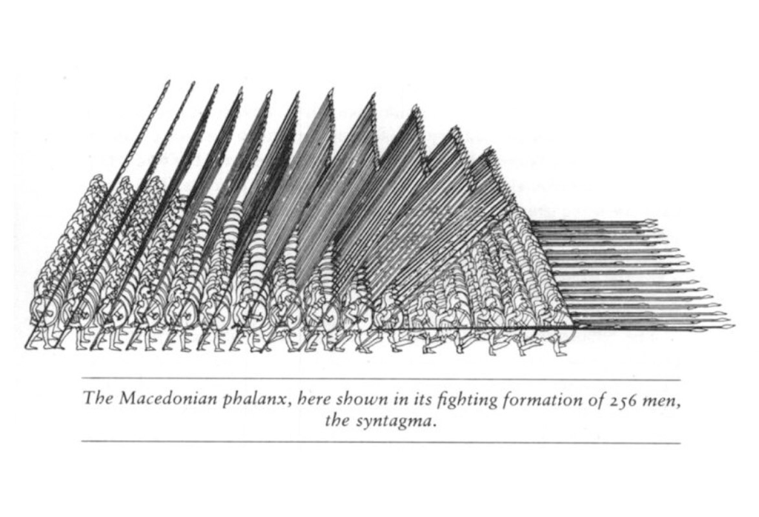

Slide 12
Cultural structures
Macedonian elite: importing significantly greater customs, artwork, and art traditions from other regions of Greece.
Macedonian metalwork usually followed Athenian styles of vase shapes from the 6th century BC onward, with drinking vessels, jewellery, containers, crowns, and coins among the many metal objects found in Macedonian tombs.
Surviving Macedonian painted artwork includes frescoes and murals on walls, but also decoration on sculpted artwork (such as statues)
Mosaics serve as another significant form of surviving Macedonian artwork, especially those discovered at Pella dating to the 4th century BC: with mythological themes
Common themes of Macedonian paintings and mosaics include warfare, hunting and aggressive masculine sexuality (i.e. abduction of women for rape or marriage)

